Slide 1

The art and science of timing pulsars
Ryan Shannon (Swinburne/OzGrav)
Notes:
Present how we have limits on GW levels to constrain the massive black hole population

Slide 2
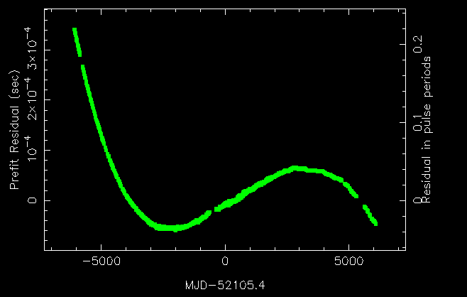
Pulsar timing
Observations of millisecond pulsar B1937+21
Power of pulsar timing technique: account for every rotation of pulsar over data set
Enables effects that only cause weak doppler shifts of pulsar to be confidently measured
Search for gravitational waves
Tests of general relativity
Masses of neutron stars
Interiors and magnetsopheres as well (glitches/magnetospheric state changes, etc.)
Purpose of this talk:
Pulsar timing methods
Pulsar timing practicalities
Last observation (2018): 674,489,762,880 pulse periods after first observation (1984)

Slide 3
Common assumptions in pulsar timing
Radio emission is ”anchored” to neutron star
Measures rotation phase of star
Radio emission is stable: emission will converge to same profile at each epoch
Notable exceptions: in precessing relativistic binaries
Many signals of scientific interest alter arrival times of pulses and don’t distort pulse shape
MAGIC collaboration

Slide 4
Pulsar folding
Pulsars are faint
For most pulsars observed with most telescopes individual pulses are indistinguishable from the noise
Average together many pulses to get achieve high S/N
In pulsar timing, we are studying known pulsars
We have a good idea model for the rotation of pulsar
Credit: R. Lynch

Slide 5
Pulsar timing
Spiewak et al. (submitted)
Pulsars have different shapes
Depends on spin properties of pulsars
Depends on viewing angle of pulsar beam
Narrow pulses provide higher timing precision
Example: MeerKAT profiles of millisecond and recycled pulsars

Slide 6
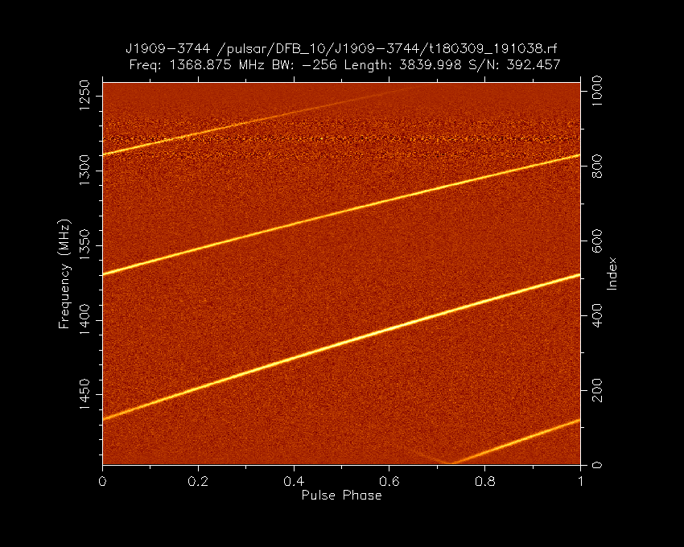
Time tagging
Historically narrow band data (< 10% fractional bandwidth)
Average in time and frequency to produce a single profile of minutes-hours of observation
Calculate stokes-I (total intensity)
Time on stokes parameters could be better!
Cross correlate observation with standard
Need to interpolate to fraction of pulse bin
Taylor (1992, Appendix A) Fourier-domain algorithm
Can do it in the time domain, but need to interpolate CCFs properly
Assumes off-pulse noise is white
Relative to timing model arrival times varied show excess white noise

Slide 7
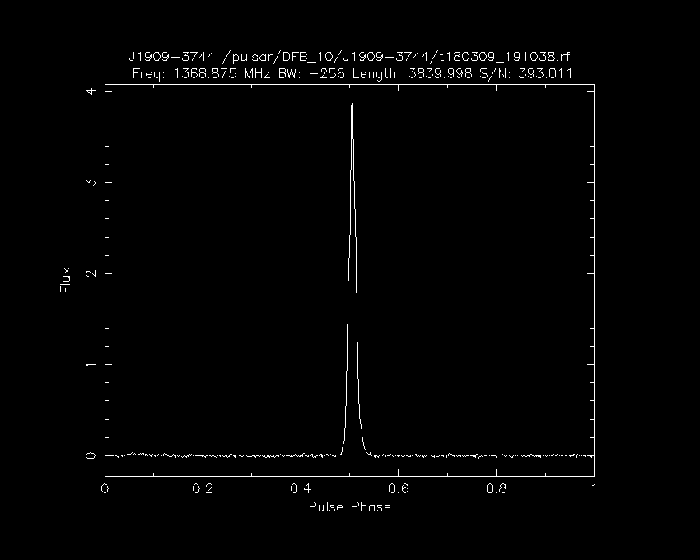
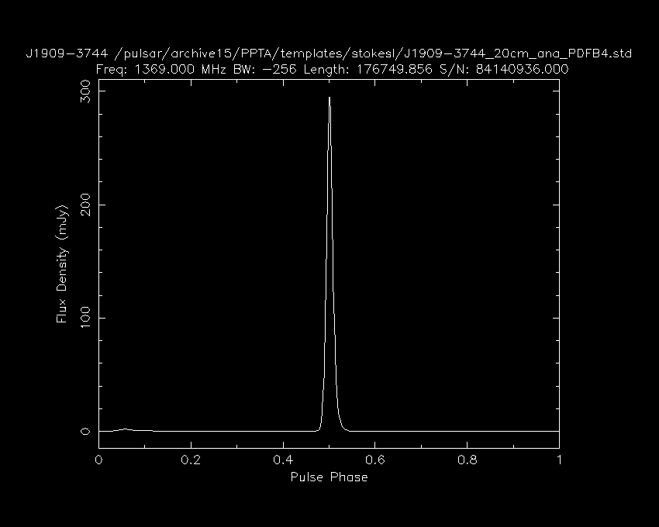
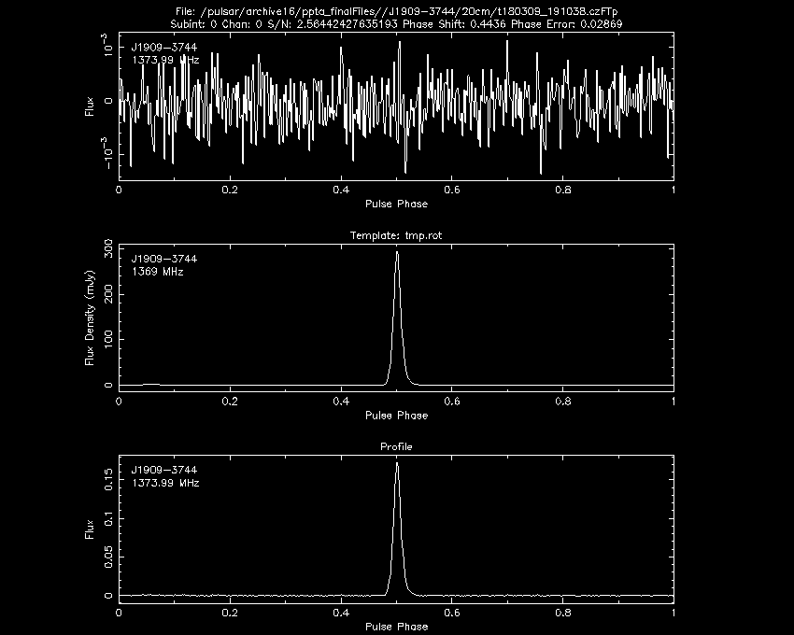
Observation
Time and frequency averaged
Example:
2018 Parkes observation of PSR J1909-3744
Template
Difference between observation and template
TOA (MJD) 58186.821751361541342
Error (microsec) 0.029

Slide 8
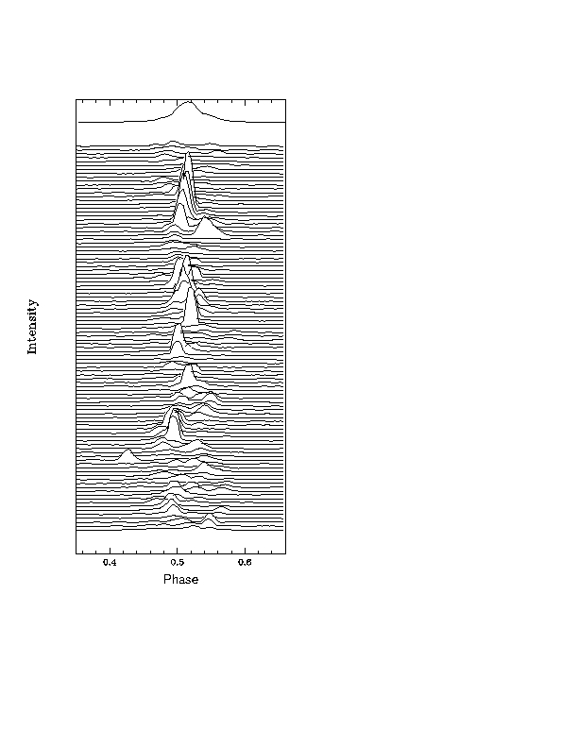
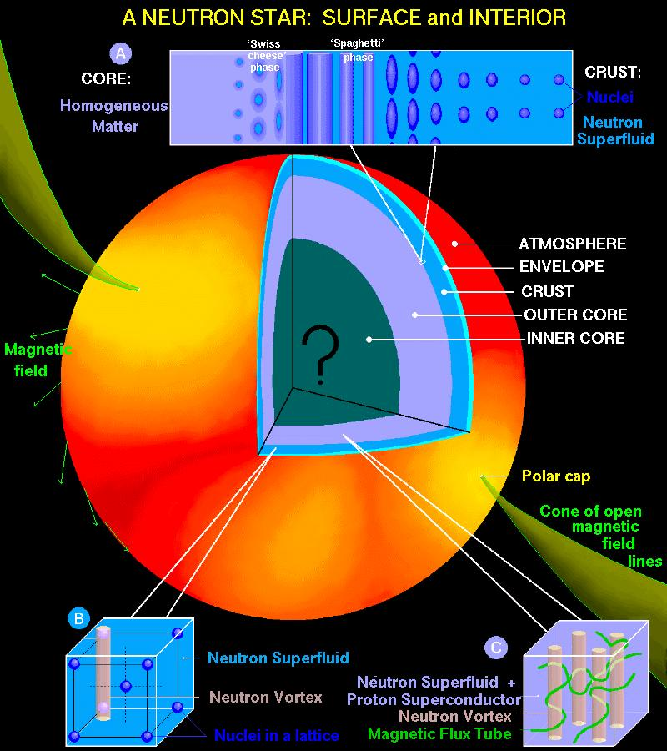
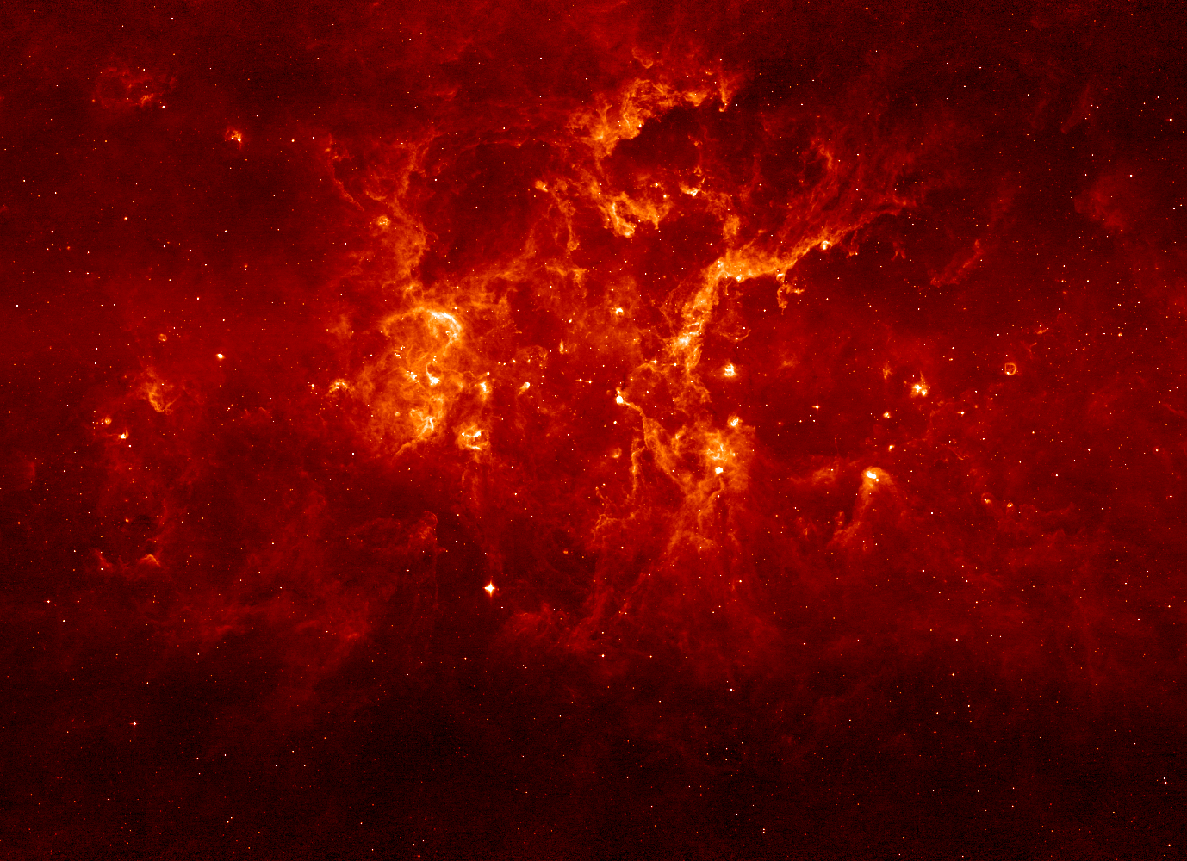
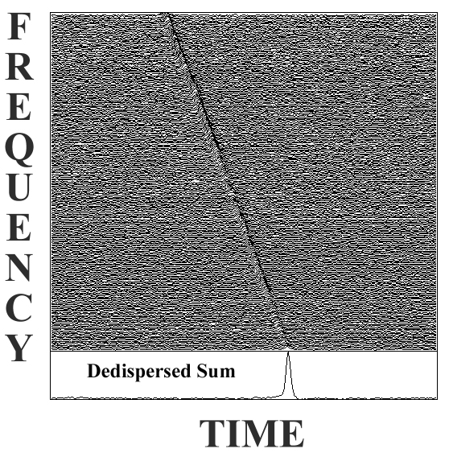
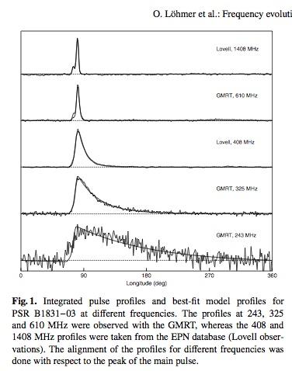
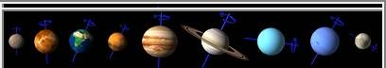
Contributions to Pulsar Arrival Times
Pulsar
Light travels 30cm in 1 ns
Pulsar spin down
Intrinsic variation in shape and/or phase of emitted pulse
Reflex motion from companions.
Pulsar position, proper motion, distance
Stochastic spindown variations
Gravitational Waves
Warm electrons in the ISM
Solar system
Earth

Slide 9
Timing model
After we discover a pulsar we build up a pulsar timing model
To test the model we form timing residuals, by comparing the measured arrival time to a model
Unmodelled or inaccurate parameters in the model lead to structure or excess noise in residuals
Need to transform arrival times to inertial reference reference frame
t_{SSB} = t_{topo} - t_{corr} – ΔDM/f⁻² - Δ_{R⨀} - Δ_{S⨀} - Δ_{E⨀}- Δ_{P⨀} - Δ_{P⨀} - Δ_{P⨀}
Measured arrival time
Clock correction
Dispersive delay
Solar-system terms
Pulsar-binary terms
See Federico’s talk!

Slide 10
Example: Deterministic contributions
Timing residuals: Difference between maximum-likelihood model and residuals
Need to refer arrival times to non-inertial frame: Solar System Barycentre.
Best model for PSR J1909-3744
No spin-down
Consequence: lowest frequency gravitational waves get absorbed into fit

Slide 11
Example: Deterministic contributions
Timing residuals: Difference between maximum-likelihood model and residuals
Need to refer arrival times to non-inertial frame: Solar System Barycentre.
Best model
Position incorrect by 1 arcsecond (1/3600 of a degree)

Slide 12
Example: Deterministic contributions
Timing residuals: Difference between maximum-likelihood model and residuals
Need to refer arrival times to non-inertial frame: Solar System Barycentre.
Best model
Timing parallax (curvature of radio waves as it passes solar system)

Slide 13
Example: Instrumental offsets
03/05/10 PDFB3 and PDFB4 firmware updated at UT0415 (MJD 55319.18) to remove delays, i.e. to make time-stamp refer to time of signal arrival at digitiser input. In case of PDFB4, the PTU was also changed to remove the two-bin delay. (V6,V3)

Slide 14
Rotational irregularities
Pulsars lose energy
Slowly spin down
Glitches: Sudden changes in pulsar spin frequency and frequency derivative
Increase in spin frequency
Common observed in young pulsars
Caused by angular momentum transfer between neutron star crust and core
Credit: Marcus Lower

Slide 15
Rotational irregularities
Pulsars lose energy
Slowly spin down
Glitches: Sudden changes in pulsar spin frequency and frequency derivative
Increase in spin frequency
Common observed in young pulsars
Caused by angular momentum transfer between neutron star crust and core
Credit: Dany Page

Slide 16
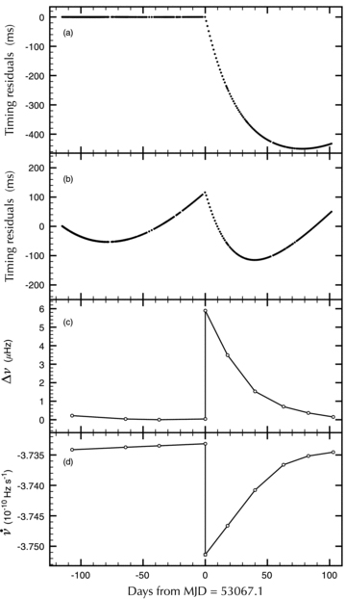
Glitches
Pulsars lose energy
Slowly spin down
Glitches: Sudden changes in pulsar spin frequency and frequency derivative
Increase in spin frequency
Common observed in young pulsars
Caused by angular momentum transfer between neutron star crust and core
Espinoza et al. (2011)

Slide 17
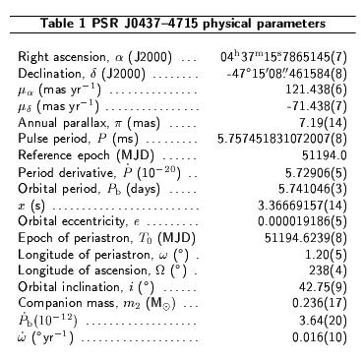
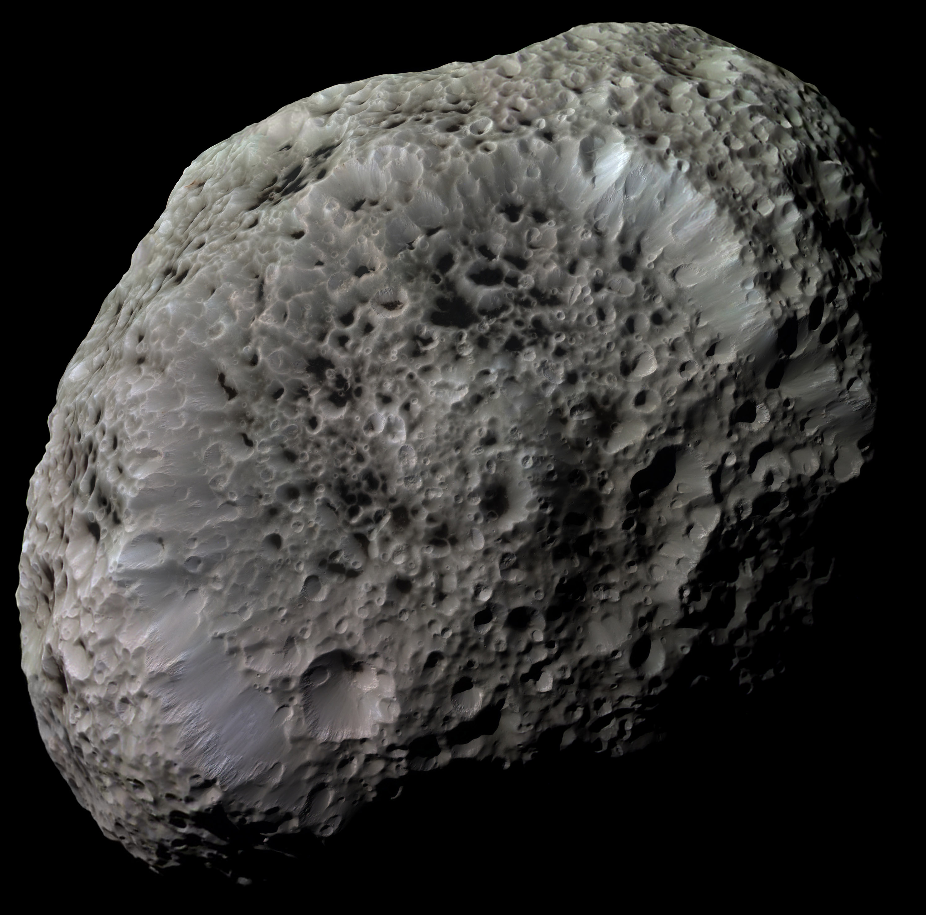
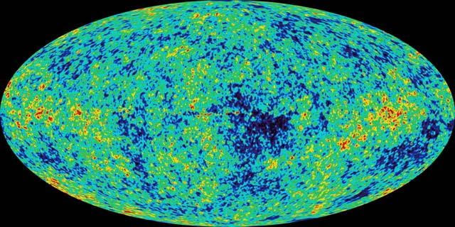
Deterministic vs. Stochastic Process
Deterministic system:
If initial state is known exactly, future state can be predicted
E.g. Pulsar, white dwarf system
Chaotic system (type of deterministic system)
If deterministic system behavior is highly sensitive to initial condition, evolution will show apparent randomness
Example: Hyperion
Stochastic system:
System evolution depends on random variables
Example CMB, Gravitational Wave Background
A large portion of the rest of the talk will be devoted to identifying, assessing, and characterizing stochastic processes.

Slide 18
Power spectral estimation in one slide
Oftentimes signals are easier expressed in the “frequency domain” rather than the time domain
Sine wave can be expressed by three numbers:
Amplitude
Frequency
Phase
Fourier transform:
Projection of time series onto set of sinusoids
Fast Fourier transform (FFT): efficient algorithm of calculating FT
Power spectrum
Square of Fourier transform
Useful if don’t care about phase of signals
In pulsar timing we use “frequency” in three contexts:
Frequency = fluctuation frequency
Frequency = radio frequency
Frequency = gravitational wave frequency
Time Series
Fourier transform

Slide 19
Classes of stochastic processes
Schematic Power Spectra
White Noise (WN)
Uncorrelated
Flat power spectrum
Red Noise (RN)
Correlated noise
Wide-sense stationary
Random walks
“Red Power spectrum” (more power at lower frequency)
Band limited noise
Red power spectrum with cut-offs
Excess power at certain frequencies
Red
Power Spectral Density
Band-limited
White Noise
Fluctuation Frequency

Slide 20
Pulse jitter
While pulsars profiles usually average to the same shape, individual pulses can have very different shapes
This introduces excess noise in arrival time measurements if not properly accounted for.
Pulse shape variations are uncorrelated pulse to pulse (or have a short correlation time)
White-noise process

Slide 21
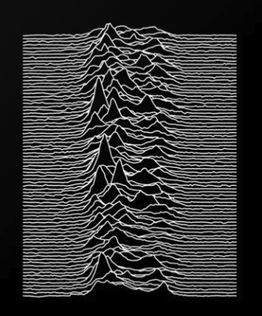
Pulse jitter
While pulsars profiles usually average to the same shape, individual pulses can have very different shapes
This introduces excess noise in arrival time measurements if not properly accounted for.
Pulse shape variations are uncorrelated pulse to pulse (or have a short correlation time)
White-noise process
Joy Division “Unknown Pleasures”

Slide 22
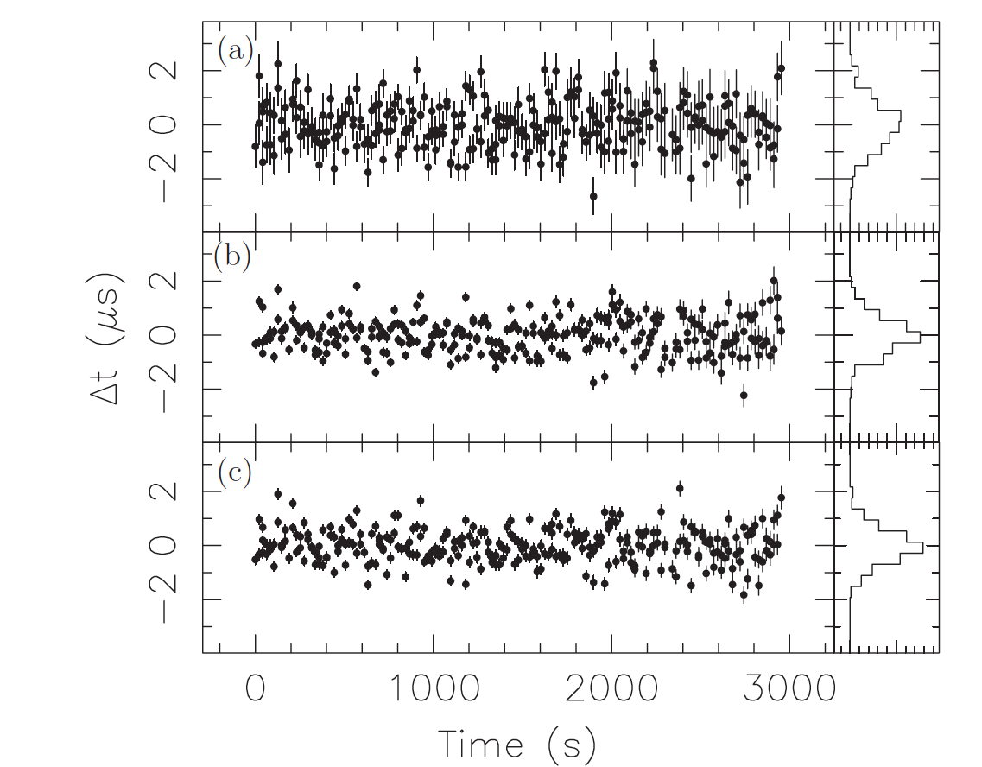
White noise
High band
Noise that is uncorrelated on TOA-TOA time scales
Radiometer noise
Pulse-shape variations (“jitter”)
Mid band
Low band
Pulse-shape variations in PSR J1713+0747 (Arecibo; Shannon & Cordes 2012)

Slide 23
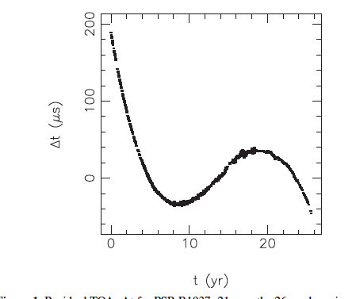
Timing noise/spin noise
Excess red noise observed in timing residuals of young pulsars
Also observed in some millisecond pulsars
Achromatic: same at all frequencies
Other achromatic red noise signal: gravitational waves
Want to account or it when undertaking tests of General relativity
MSP PSR B1937+21

Slide 24
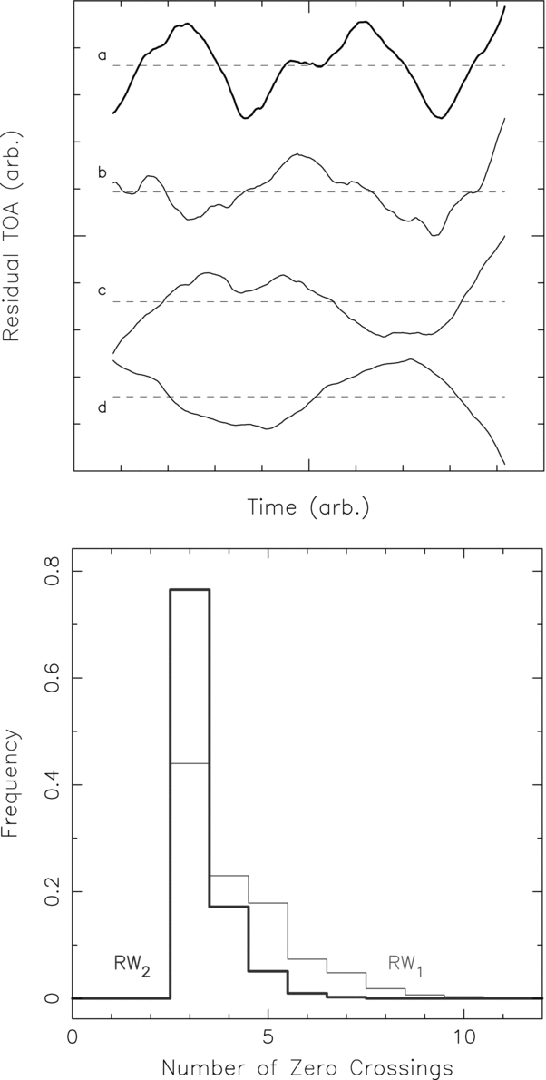
Simulated red noise
Realisations of the same statistically identical noise process
Red noise in an individual pulsar can have very similar shape to gravitational waves but also can potentially impact measurements of binary parameters in relativistic pulsars
Want to account for it when measuring pulsar parameters

Slide 25
Red noise
PSR J1024-0719
Most young pulsars show red spin noise
Rotation instabilities?
Magnetospheric torque changes?
Open question: is this a generic property of MSPs too?
Can have similar spectral properties to GWB
Solution: need to (at least) model the presence of red noise in datasets
Wide companion
Kaplan et al (2015),
Bassa et al. (2015).
2003
2014
PSR J1909-3744
MSP PSR B1937+21

Slide 26
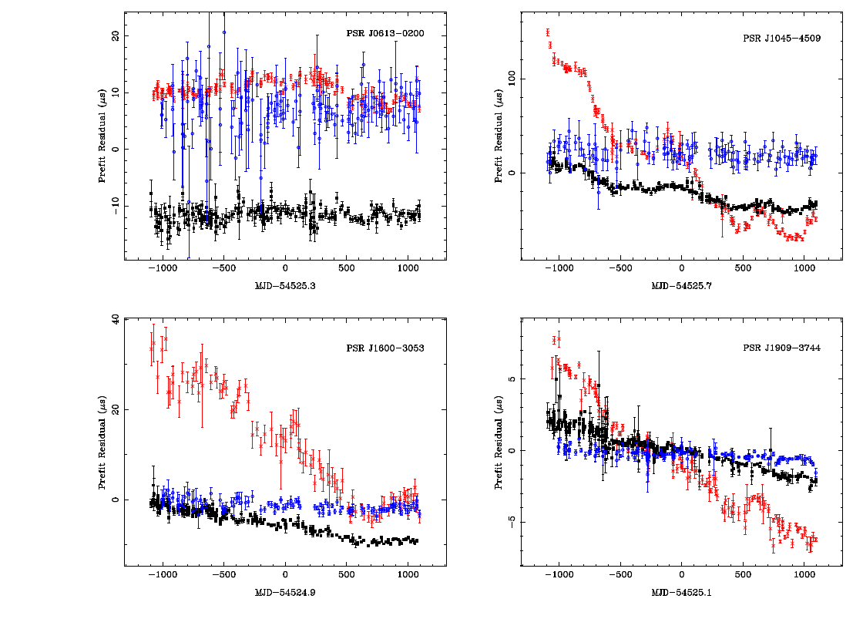
Red noise from the interstellar medium
Largest red signal in data set: Variations in dispersion measure (DM).
Proportional to λ².
Need to remove red signal associated with DM variations without removing red signal associated with GWB
Include model of λ-independent in DM correction algorithm (Shannon 2011, Keith et al. 2013, Lee et al. 2014, Lentati et al. 2014)

Slide 27
Modelling noise
White noise:
Modification to TOA uncertainties: EFAC and EQUAD
Red noise: power spectrum
Useful for wide-sense stationary processes
Maps onto gravitational wave background
Power law: P_{r}(f) = A f^{-β}
In Bayesian methods A and β can be directly included in model
More complicated models appropriate for band-limited processes
Band noise
System noise
Non-stationary models

Slide 28
Signal model for pulsar timing
TOAs = timing model + white noise + red noise
Timing model = deterministic terms
Red noise = (gravitational waves) + spin noise + ISM noise + …
White noise = radiometer noise + pulse jitter + instrumental effects
Can fit/marginalize deterministic terms without too much fuss
Want to minimize stochastic contributions relative to GWs
Need to incorporate stochastic contributions into Likelihood function

Slide 29
Maximum-likelihood methods
If observations are normally distributed, can calculate the probability (p) that the parameters agree with the data:
d_{i} = data points
s_{i} = model at data points
σ = uncertainty in model
Strategy 1: find parameters that maximize probability (usually minimize –log(p)=“χ²“

Slide 30
Maximum-likelihood methods
If parameters are linear, then the problem is linear, and parameters (and uncertainties) can be solved for using a set of linear equations
Convergence in single iteration of fit
There is a unique global minimum
If model is non-linear it is often possible to linearise the problem about initial parameters
Binary orbital parameters are very non-linear
Convergence may take a few iterations if close to minimum
Not guaranteed to find global minimum
Downsides:
Difficult quantify the effect of assumptions in the uncertainties
Parameter uncertainties can be incorrect (especially when parameter is detected with low significance
Doesn’t account for covariance between deterministic and stochastic processes

Slide 31
Introduction to tempo2
Software that analyses TOAs
Input
Arrival times (.tim file)
Initial timing model (.par file)
Solar system ephemeris
Output
Timing residuals
Updated timing model

Slide 32
TOA file (“timfile”, .tim)
Define TOA file format
FORMAT 1
2019-08-12-15:00:40_zap.FTp.ar 1284.360000 58707.631479199641432 2.909 meerkat
2019-11-12-17:40:32_zap.FTp.ar 1296.685000 58799.742474567748197 3.180 meerkat
2019-11-20-05:42:08_zap.FTp.ar 1283.143000 58807.240693679902220 3.718 meerkat
2019-12-27-11:45:20_zap.FTp.ar 1286.831000 58844.495775240801992 2.581 meerkat
2020-01-07-10:58:08_zap.FTp.ar 1292.323000 58855.460092791077399 7.167 meerkat
2020-02-17-23:27:12_zap.FTp.ar 1291.422000 58896.980213268256267 4.042 meerkat
2020-08-22-15:26:08_zap.FTp.ar 1293.386000 59083.654985314098427 1.966 meerkat
Filename used to produce TOA
Observing Frequency (MHz)
Arrival time (MJD)
Uncertainty
(μs)
Telescope ID

Slide 33
TOA file (“timfile”, .tim)
Can add additional columns to “flag” TOAS
Useful when combining data from multiple telescopes or observing systems
Can have multiple flags on a single observation
2020-08-22-15:26:08_zap.FTp.ar 1293.386000 59083.654985314098427 1.966 meerkat -fe KAT -be MKBF -f KAT_MKBF -bw 856 -tobs 2047.5 -tmplt /fred/oz002/users/mmiles/templates/msp_templates//J1618-4624.std -gof 1.45 -nbin 1024 -nch 1024

Slide 34
TOA file (“timfile”, .tim)
FORMAT 1
2019-08-12-15:00:40_zap.FTp.ar 1284.360000 58707.631479199641432 2.909 meerkat
2019-11-12-17:40:32_zap.FTp.ar 1296.685000 58799.742474567748197 3.180 meerkat
2019-11-20-05:42:08_zap.FTp.ar 1283.143000 58807.240693679902220 3.718 meerkat
2019-12-27-11:45:20_zap.FTp.ar 1286.831000 58844.495775240801992 2.581 meerkat
2020-01-07-10:58:08_zap.FTp.ar 1292.323000 58855.460092791077399 7.167 meerkat
2020-02-17-23:27:12_zap.FTp.ar 1291.422000 58896.980213268256267 4.042 meerkat
2020-08-22-15:26:08_zap.FTp.ar 1293.386000 59083.654985314098427 1.966 meerkat

Slide 35
Parameter file (parfile .par)
Contains model for arrival times
Pulsar spin
Binary models (See Federico’s talk)
ISM
Solar system
Astrometry (position, proper motion parallax)
Model of the solar system

Slide 36
Example .par file
Parameter name
Parameter value
Fitted?
Uncertainty
PSRJ J2124-3358
RAJ 21:24:43.8458698 1 0.00000583135646094931
DECJ -33:58:45.00654 1 0.00015236163760310887
F0 202.793893699615265 1 0.00000000000113190564
F1 -8.4593297850997264368e-16 1 1.7422206699012692418e-20
DM 4.59585561257238 1 6.8072e-05
PEPOCH 55635
POSEPOCH 55635
DMEPOCH 55635
PMRA -14.10871339972822112 1 0.01926194687501067899
PMDEC -50.357587040403972975 1 0.03919424506154254445
PX 2.2175016068272757417 1 0.20420137814758584915
TRES 5.048
CLK TT(BIPM2018)
UNITS TCB
EPHEM DE436

Slide 37
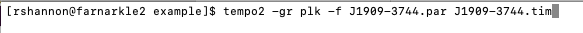
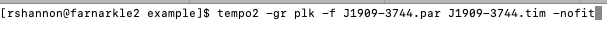
Running tempo2
Run from command line
Use “plk” plugin to visual data
> tempo2 –gr plk -f <parfile> <timfile>
Disable fitting:

Slide 38
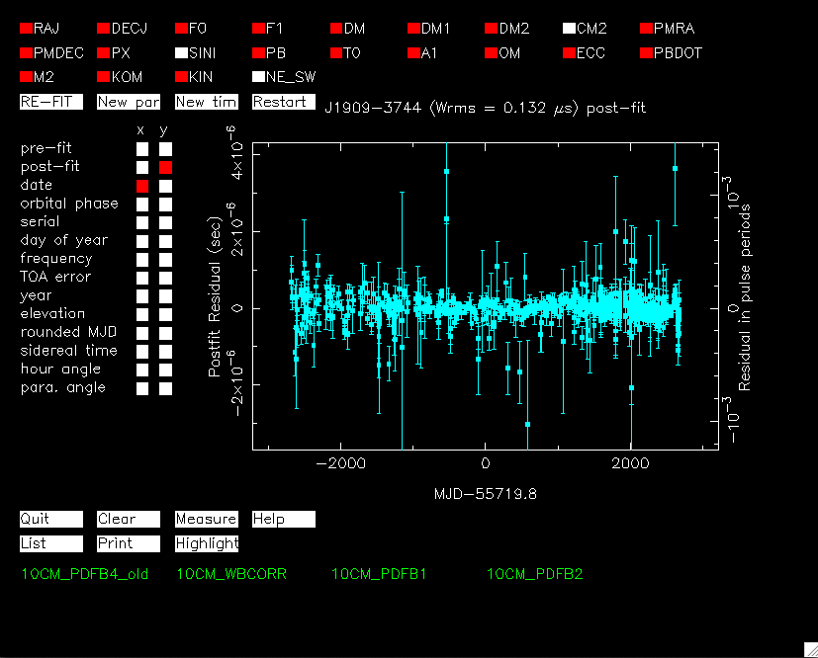
Refit model
Parameters
(Red: fitted)
(White: not fitted)
New .par file
New .tim file
Plotting options
Residuals:
Colour-coded by observing frequency
Quit
Jumps

Slide 39
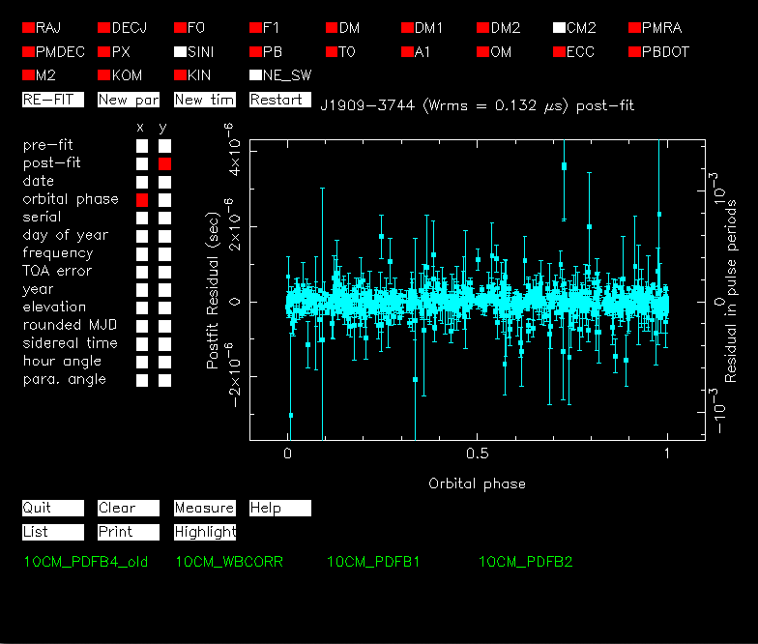
Orbital phase

Slide 40
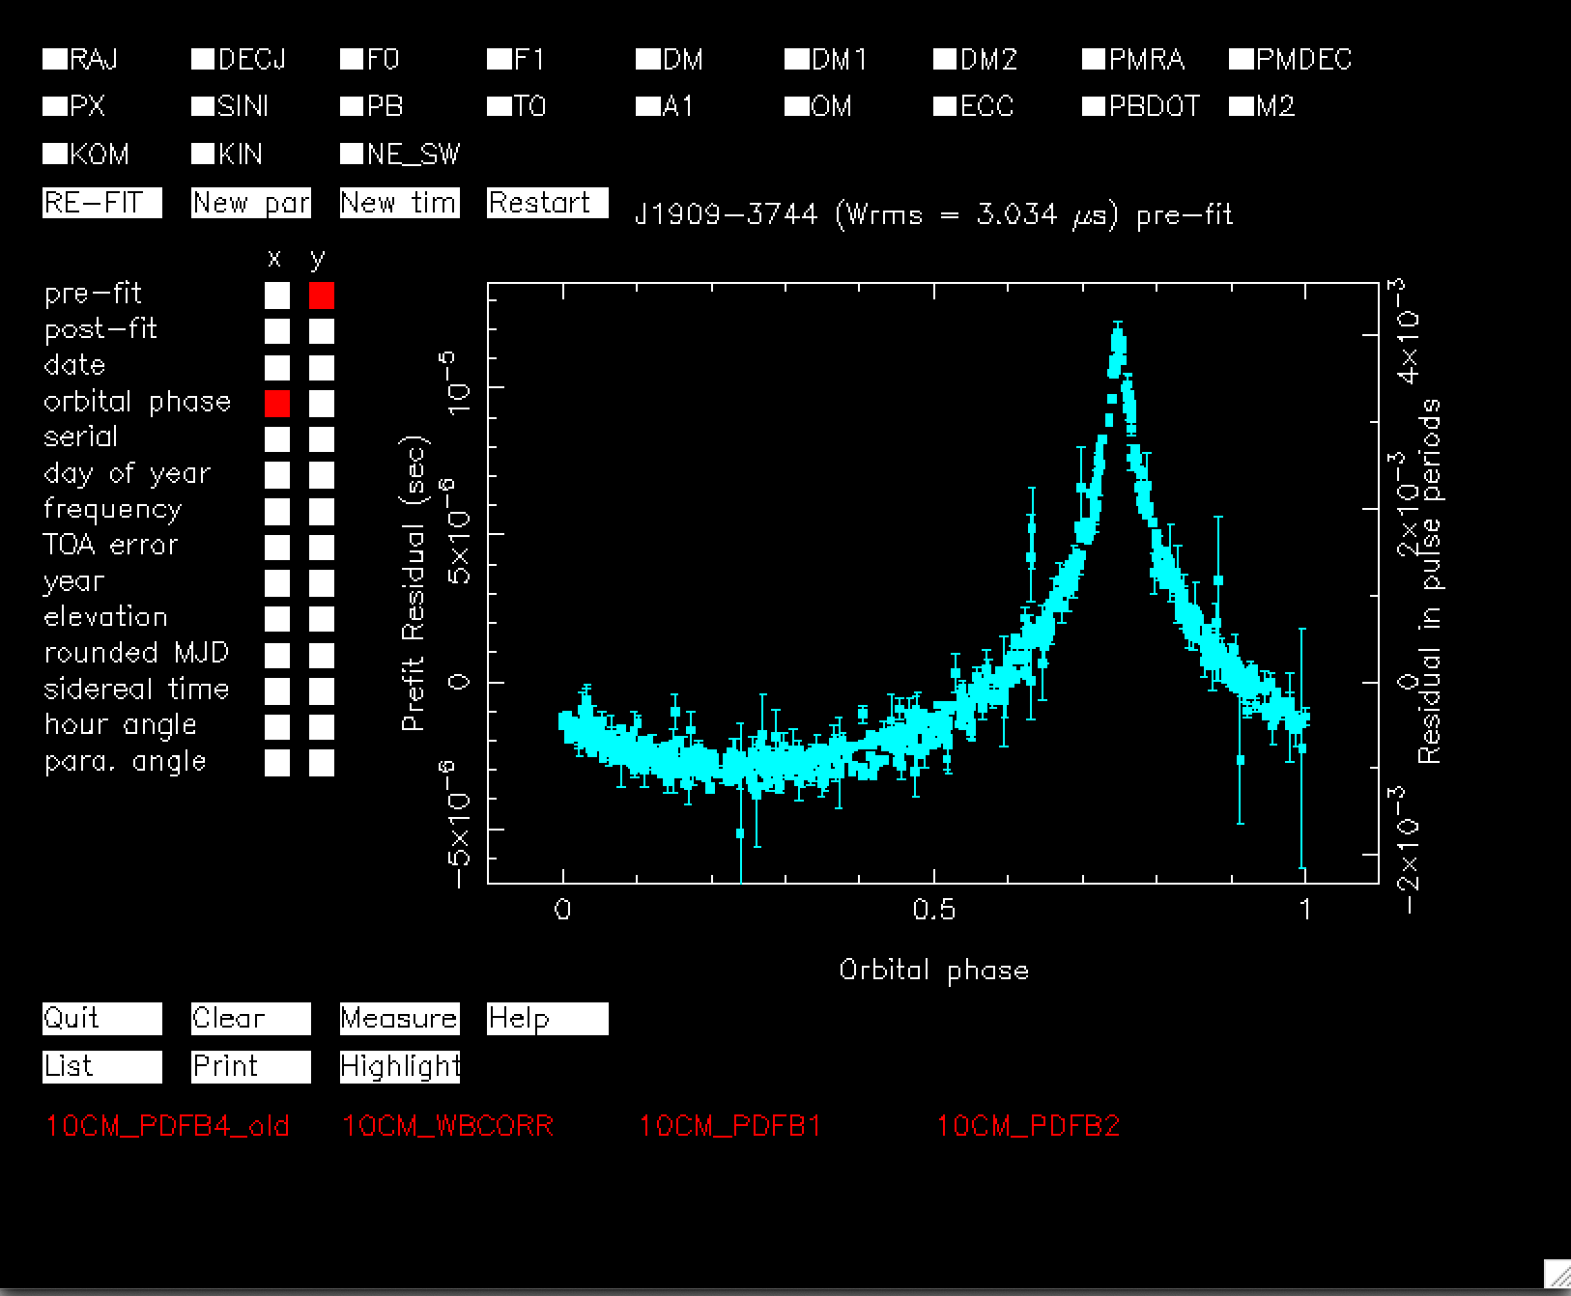
Orbital phase

Slide 41
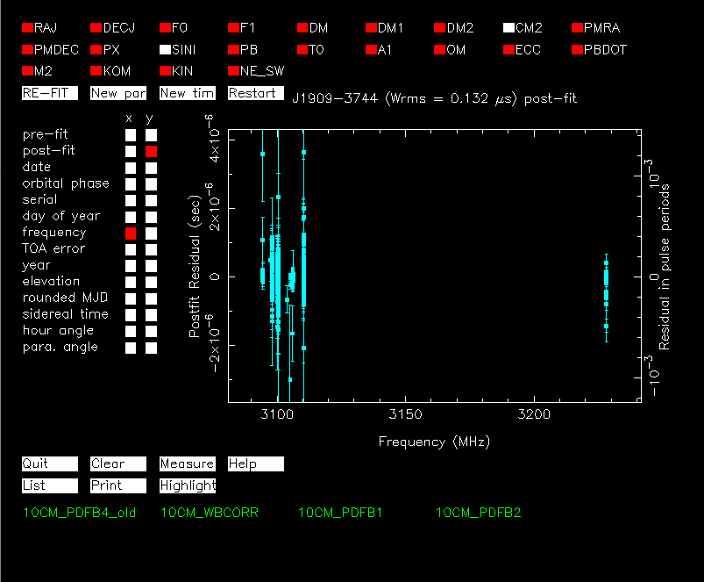
Frequency

Slide 42
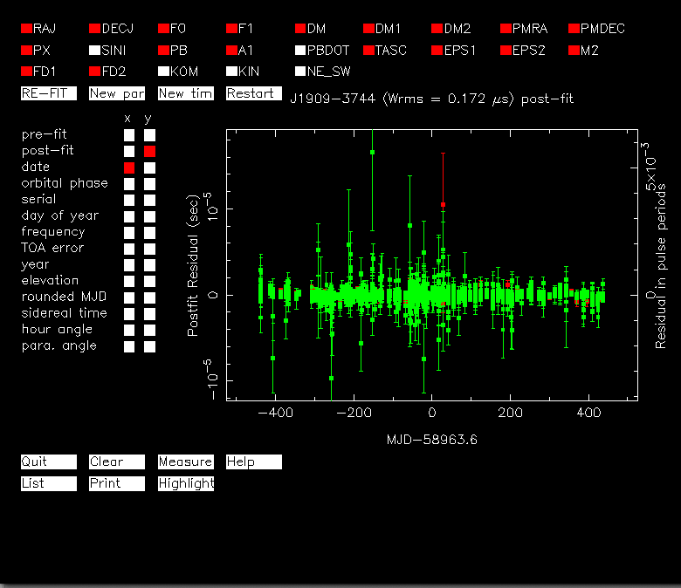
MeerKAT J1909-3744 data

Slide 43
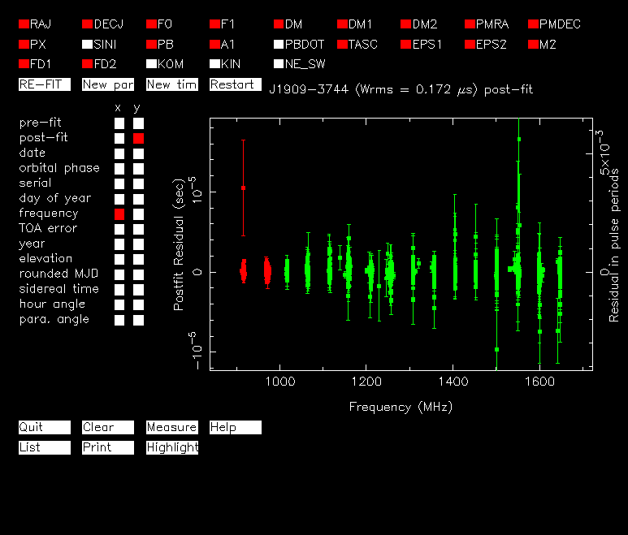
MeerKAT J1909-3744 data vs. frequency

Slide 44
Functionality in tempo2/plk
Rich set of ways to interact/curate/edit TOAs
Mouse
Left click: information about TOA printed to window
Right click: delete/zap TOA
Keyboard commands over plk window
z – zoom in to a region
Z – remove TOAs in a region
x – refit
s – zoom starting at this time and then f – zoom ending at this time

Slide 45
Strategy 2: Bayesian analysis
Want to calculate probability of Model M with parameters X given data D
Bayes Theorem:
p(X|D,M) = p(D|X,M)P(X|M)/P(D|M)
Posterior probability: P(X|D,M) (the question you want to answer)
Likelihood: P(D|X,M) (How well does you data match the parameters and model )
Prior: P(X|M) (The range of expected values for the parameters)
Usually choose flat (uniformed priors), but can also choose physical priors
Evidence: P(D|M) (How well the model matches the data)

Slide 46
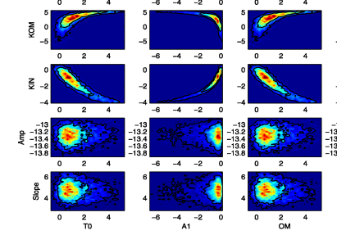
Strategy 2: Bayesian analysis
Instead of finding the most likely set of parameters we consider parameters (or sets of parameters) of interest and marginalize over the rest
Complete picture for the probability distribution for a given parameter

Slide 47
Calculating p(X|D,M)
Challenge: for parameter estimation, want to marginalize over parameters that you don’t care about (or care about independently)
For Gaussian distributions with flat priors this can be calculated analytically
Need creative (numerical) way to sample p(X|D,M) for complicated PDFs.
Various algorithms:
Markov-chain Monte Carlo (MCMC), Nested Sampling, Polychord, etc.

Slide 48
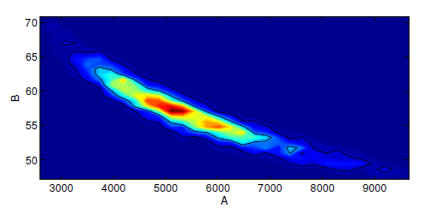
Marginalization
Key to Bayesian analysis: Integrate over ‘nuisance’ parameters, characterise the parameters that you are interested in
Things you don’t care about but that affect the answer you want
Consider 2-dimensional problem –
Probability density for parameters
A and B.

Slide 49
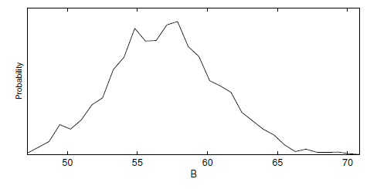
Marginalization
Can marginalise numerically after sampling
Integrate over A to get the probability of B

Slide 50
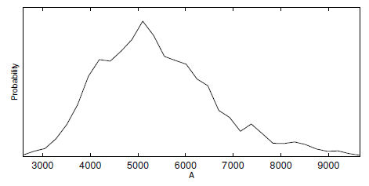
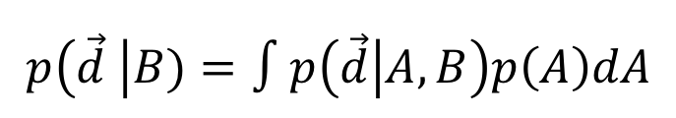
Can marginalize numerically after sampling
Can marginalise numerically after sampling
Can also marginalise analytically
$$p\left(\vec{d} \right|B)=∫p\left(\vec{d} | A,B\right)p\left(A\right)dA$$
Integrate over B to get the probability of A

Slide 51
The evidence
Evidence is the integral of the likelihood function over the prior
Used to evaluate the relative probabilities of different hypotheses
Again, difficult to calculate for large parameter spaces

Slide 52
Evidence comparison
Require increase in evidence to warrant more complicated model

Slide 53
Tests for Gaussianity
Why bother?
Departures would signify that there is a breakdown of the assumptions about contributions to the measurements
Will bias your parameter estimation/posterior distribution
Probably indicates contamination from:
radio-frequency interference
interstellar focusing effects
events within the pulsar
Can do moment tests:
asymmetry of the PDF of timing residuals
kurtosis, etc.
Lentati et al. (2015)

Slide 54
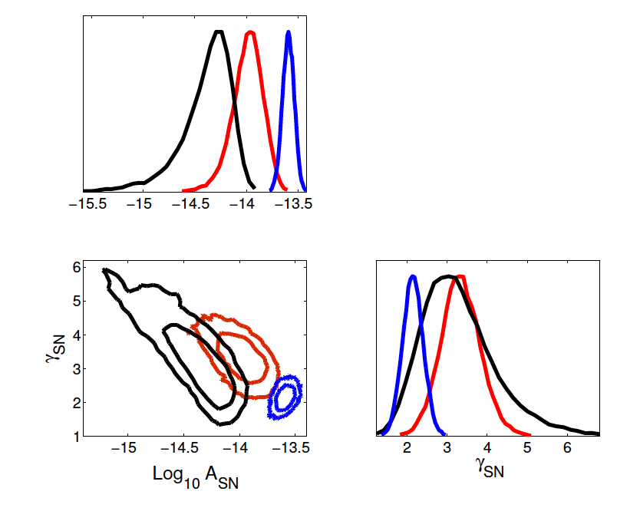
Example: characterizing red noise
Three data sets:
IPTA – first data release
NANOGrav 9 yr
PPTA – same 9 yr as Nanograv
“Triangle plots”
Red noise in IPTA (black),PPTA-dr2 (red) and NANOGrav datasets (blue)
PSR B1937+21
54 |

Slide 55
Interpreting results of timing model
Visual inspection?
Do the residuals look weird (sinusoidal trends vs time or orbital phase)
How good is the fit? How good is the model?
Are parameters significant? Do their values make sense?
Do parameters improve the fit/increase the evidence?
Are parameters consistent?
Geometric parallax / vs Change in orbital period
Consistent with other observatories, IPTA
Red noise in IPTA (black),PPTA-dr2 (red) and NANOGrav datasets (blue)

Slide 56
Ryan’s recipe for precision timing
Use tempo2 graphical plugin to inspect residuals
“Bailes” Method -> remove the low S/N TOAs and see what is left
Sort by frequency/flag by backend, etc.
Average data together to see what low S/N signals exist
Use maximum-likelihood methods to explore data
What are the important parameters?
What are the important noise sources?
Use Bayesian methods to explore the models
How are parameters covariant?
Which parameters/models are supported?

Slide 57
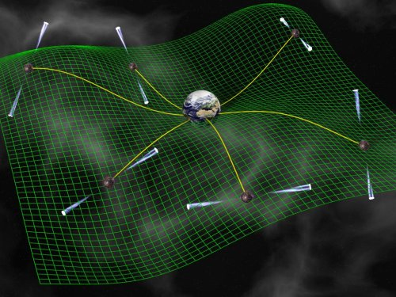
Why pulsar timing is awesome
Measure path length differences to 3 m to objects that are > 3x10¹⁹ m distance
Search for subtle distortion in space time between the pulsars and Earth: gravitational waves
Test theories of gravity (General Relativity)
Study the equation of state of Nuclear Matter (through neutron star mass measurements)
Thank you
Schematic representation of Pulsar Timing Array
Credit: David Champion

